Slide 1

Mrs. Salow
2017-2018

Slide 2

~Reader, Writer, Artist, Crafter, Biker, Swimmer, Collector, Camper, Beach-comber
~Daughter, Wife, Mother
~26th year at HH
~BA in Science & Social Studies

Slide 3

8:45 School Day Begins
9:05 Rotations Start
(Science, Social Studies, Math)
12:25 Lunch & Recess
Afternoon-ELA (Reading, Writing, Grammar, Spelling)
1:35 Thurs/Fri Specials
2:55 Mon-Thurs Specials
3:35 School dismisses

Slide 4

~Be the Best YOU can Be!
~Give 100%,
100% of the time!
~Follow the Golden Rule
~Be Kind Always
~Be Respectful
~Be Responsible

Slide 5

~Listen while others are talking.
~Follow directions quickly.
~Raise your hand to speak.
~Respect yourself, others, and your school.
~Be safe, be kind, be honest.
~Always do your best.

Slide 6

~Get off the bus quickly.
~Put coat & backpack in the cafe’.
~Wait patiently & quietly in line.
~Eat in café or bring food to classroom.
~Dispose of crumbs & tray.

Slide 7

When dismissed for lunch:
Hot lunch-get your lunch card & line up in classroom.
Cold lunch-get your lunch & line up along the wall.
Walk down the hall
quietly & quickly.

Slide 8

Any assignment not completed during the school day is to be finished at home and returned the following day. If assignment is
not completed,
it will need to be finished
before recess.

Slide 9

It is important to call the office when your child is absent. If your child has a medical appointment, please ask the doctor’s office for
a school excuse note.

Slide 10

Literature & Informational
Interactive Notebook
Book Clubs
Accelerated Reader
Read Alouds
Guest Readers
Textbook & Leveled Readers

Slide 11

Write-Steps Program
Interactive Notebook
Narrative, Persuasive, Opinion, & Informational Writings
Journals
Author’s Chair
Cit Pat Poetry Contest
Essay Contest
Poster Contests

Slide 12

Taught by Mrs. Swihart
Engage NY
Zearn
Problem of the Day 3 Ways

Slide 13

Taught by Mrs. Salow
Physical Science-States of Matter
Life Science-Plants & Animals
Earth Science-Moon Phases & Seasons

Slide 14

Taught by Mrs. Raburn
American Government
American History through the Revolution
Economics-Junior Achievement
Civics

Slide 15

If you own any laptops, Chromebooks, I-pads, kindles, etc. that you don’t use, please consider donating them to the classroom.
~Thanks!

Slide 16

PLAY PLAY PLAY
No mean words
No mean gestures
No mean actions
Make your own fun!
As Woody said to Sid…
“SO PLAY NICE!”

Slide 17

All students must be in the classroom at their desk working on Morning Task when the 8:45 starting bell rings.
Turn in completed assignments/notes/lunch money.
Put up name tag.
Order lunch.
Organize your supplies & desk.
Do your classroom job.
Work on Morning Task assignment.

Slide 18

Team-Building Camp
Roller-skating
Sauder Village
Air Zoo
STEM Days
???

Slide 19

SEUSS Folder:
Includes assignments to complete at home, graded papers, notes from school, newsletters, study guides, academic information, planner, etc.
Take to school & home DAILY
Please sign DAILY after checking that assignments are complete.
Put notes for me into the folder.

Slide 20

Binders-one 1 inch and one
1½ inch with front view pockets
10 dividers with pockets
One package of sheet protectors
Two 3-ring pencil pouches

Slide 21
Suggested/Optional
Index cards
Tissues
Anti-bacterial cleaning wipes
Plastic forks/spoons
Pens
Zip-lock bags-all sizes
Band-aids
Colored pencils
Highlighters

Slide 22

If you would like to send birthday treats for your child to share, PLEASE contact me at least 2 days in ADVANCE to arrange a time. You also must provide all needed plates, cups, utensils, napkins, etc. Thank you for understanding. Unplanned birthday treats do not make your child feel special, especially when they have to be crammed into a full schedule and have limited time to properly celebrate your child’s birthday.

Slide 23

Fall Festival (instead of Halloween party)
Christmas Party
Valentine’s Roller-Skating Party
Pi Day
Carnival
Field Day
???

Slide 24
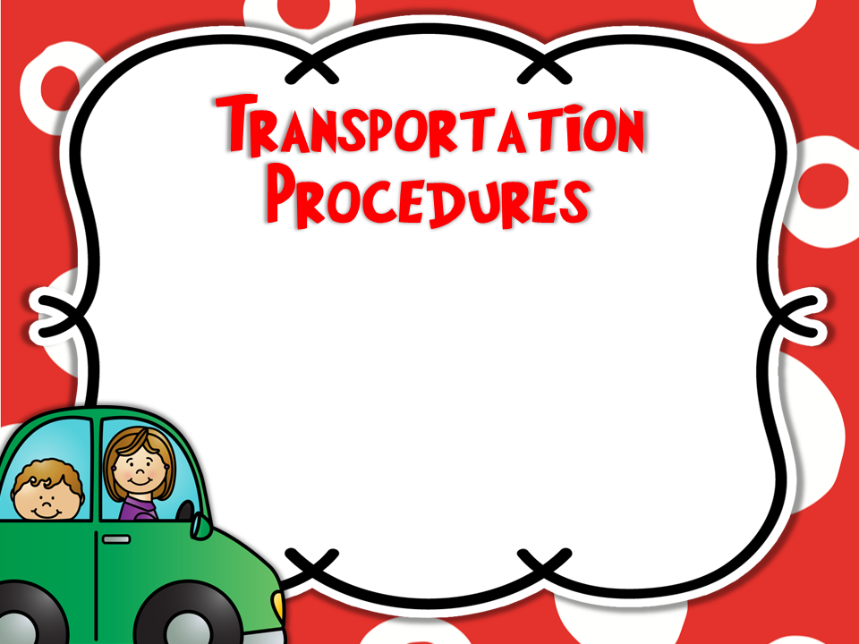
If your child’s departure from school procedure will change on any given day, please write a note in his/her
planner.

Slide 25

Please sign-up on the Volunteer Sheet if you want to help during the school day, for special days, parties, and/or field trips.

Slide 26

Best ways to stay informed:
Sign up for PowerSchool
Friend request Salowmander’s Classroom on Facebook
Check your child’s planner
Visit my webpage
Email-kathy.salow@hanoverhorton.org

Slide 27

Wed, Aug, 23-First ½ day (End-12:15)
Tues, Aug. 29-Team Building Camp
Fri & Mon, Sept. 1 & 4-NO School
Fri, Oct. 20-End of 1st Quarter
Fri, Oct. 27-Family Fall Festival
Thurs & Fri, Nov. 2 & 3-Conferences
Wed, Thurs, & Fri, Nov.22, 23, & 24-NO School
Fri, Dec. 22-Half Day

Slide 28

The very best way to contact me if it’s not urgent is by email:
kathy.salow@hanoverhorton.org
For information that needs my attention immediately (emergencies, transportation changes, & the like:
Call the office at 517-563-0103
Do NOT leave a message on my phone for these. I may not get them in time. Tell the secretary & she will make sure I get your
message.

Slide 29

Specials Times:
Mon.-STEAM @ 2:50-3:25
Tues.-Book Check-Out @ 2:30
Library @ 2:50-3:25
Wed.-Gym @ 2:50-3:25 *We do NOT
change clothes for gym, just shoes!
Thurs.-Technology @ 1:35-2:10
STEAM @ 2:50-3:25
Fri.-Gym @ 1:35-2:10

Slide 30

CLASS THEME
The Wisdom of Dr. Seuss:
Not Just for Little Kids…
“You have BRAINS in your HEAD
You have FEET in your SHOES
You can steer YOURSELF
In any direction YOU choose!”
~Dr. Seuss

Slide 31

What It Means…
To me, the previous quote means many things:
You can do amazing things!
You can do anything you set your mind to doing!
You control your own self-your dreams,
your destiny, your success, your life!
You can change the direction of your circumstances and life!

Slide 32

“Oh, the Places You’ll Go!”
“Go Farther, Together.” You’ve probably heard this and it’s true. When we (teachers, students, parents, school, & community) work together instead of separately or against each other, everyone, especially the students, accomplishes more, learns more, succeeds faster,
reaches dreams, and sets themselves
in a positive direction.

Slide 33

“And will you SUCEED?
YES! You will, indeed!
(98 ¾ percent guaranteed!)
~Dr. Seuss
I believe all kids who have a willingness to work and a positive outlook will achieve growth & success.

Slide 34

Contact Info:
Email: kathy.salow@hanoverhorton.org
Phone: 517-563-0103
Website: salowmanders.weebly.com
Facebook: Salowmander’s Classroom
Instagram: salowmanders_classroom
Twitter: Salowmander’s Class

